Slide 1
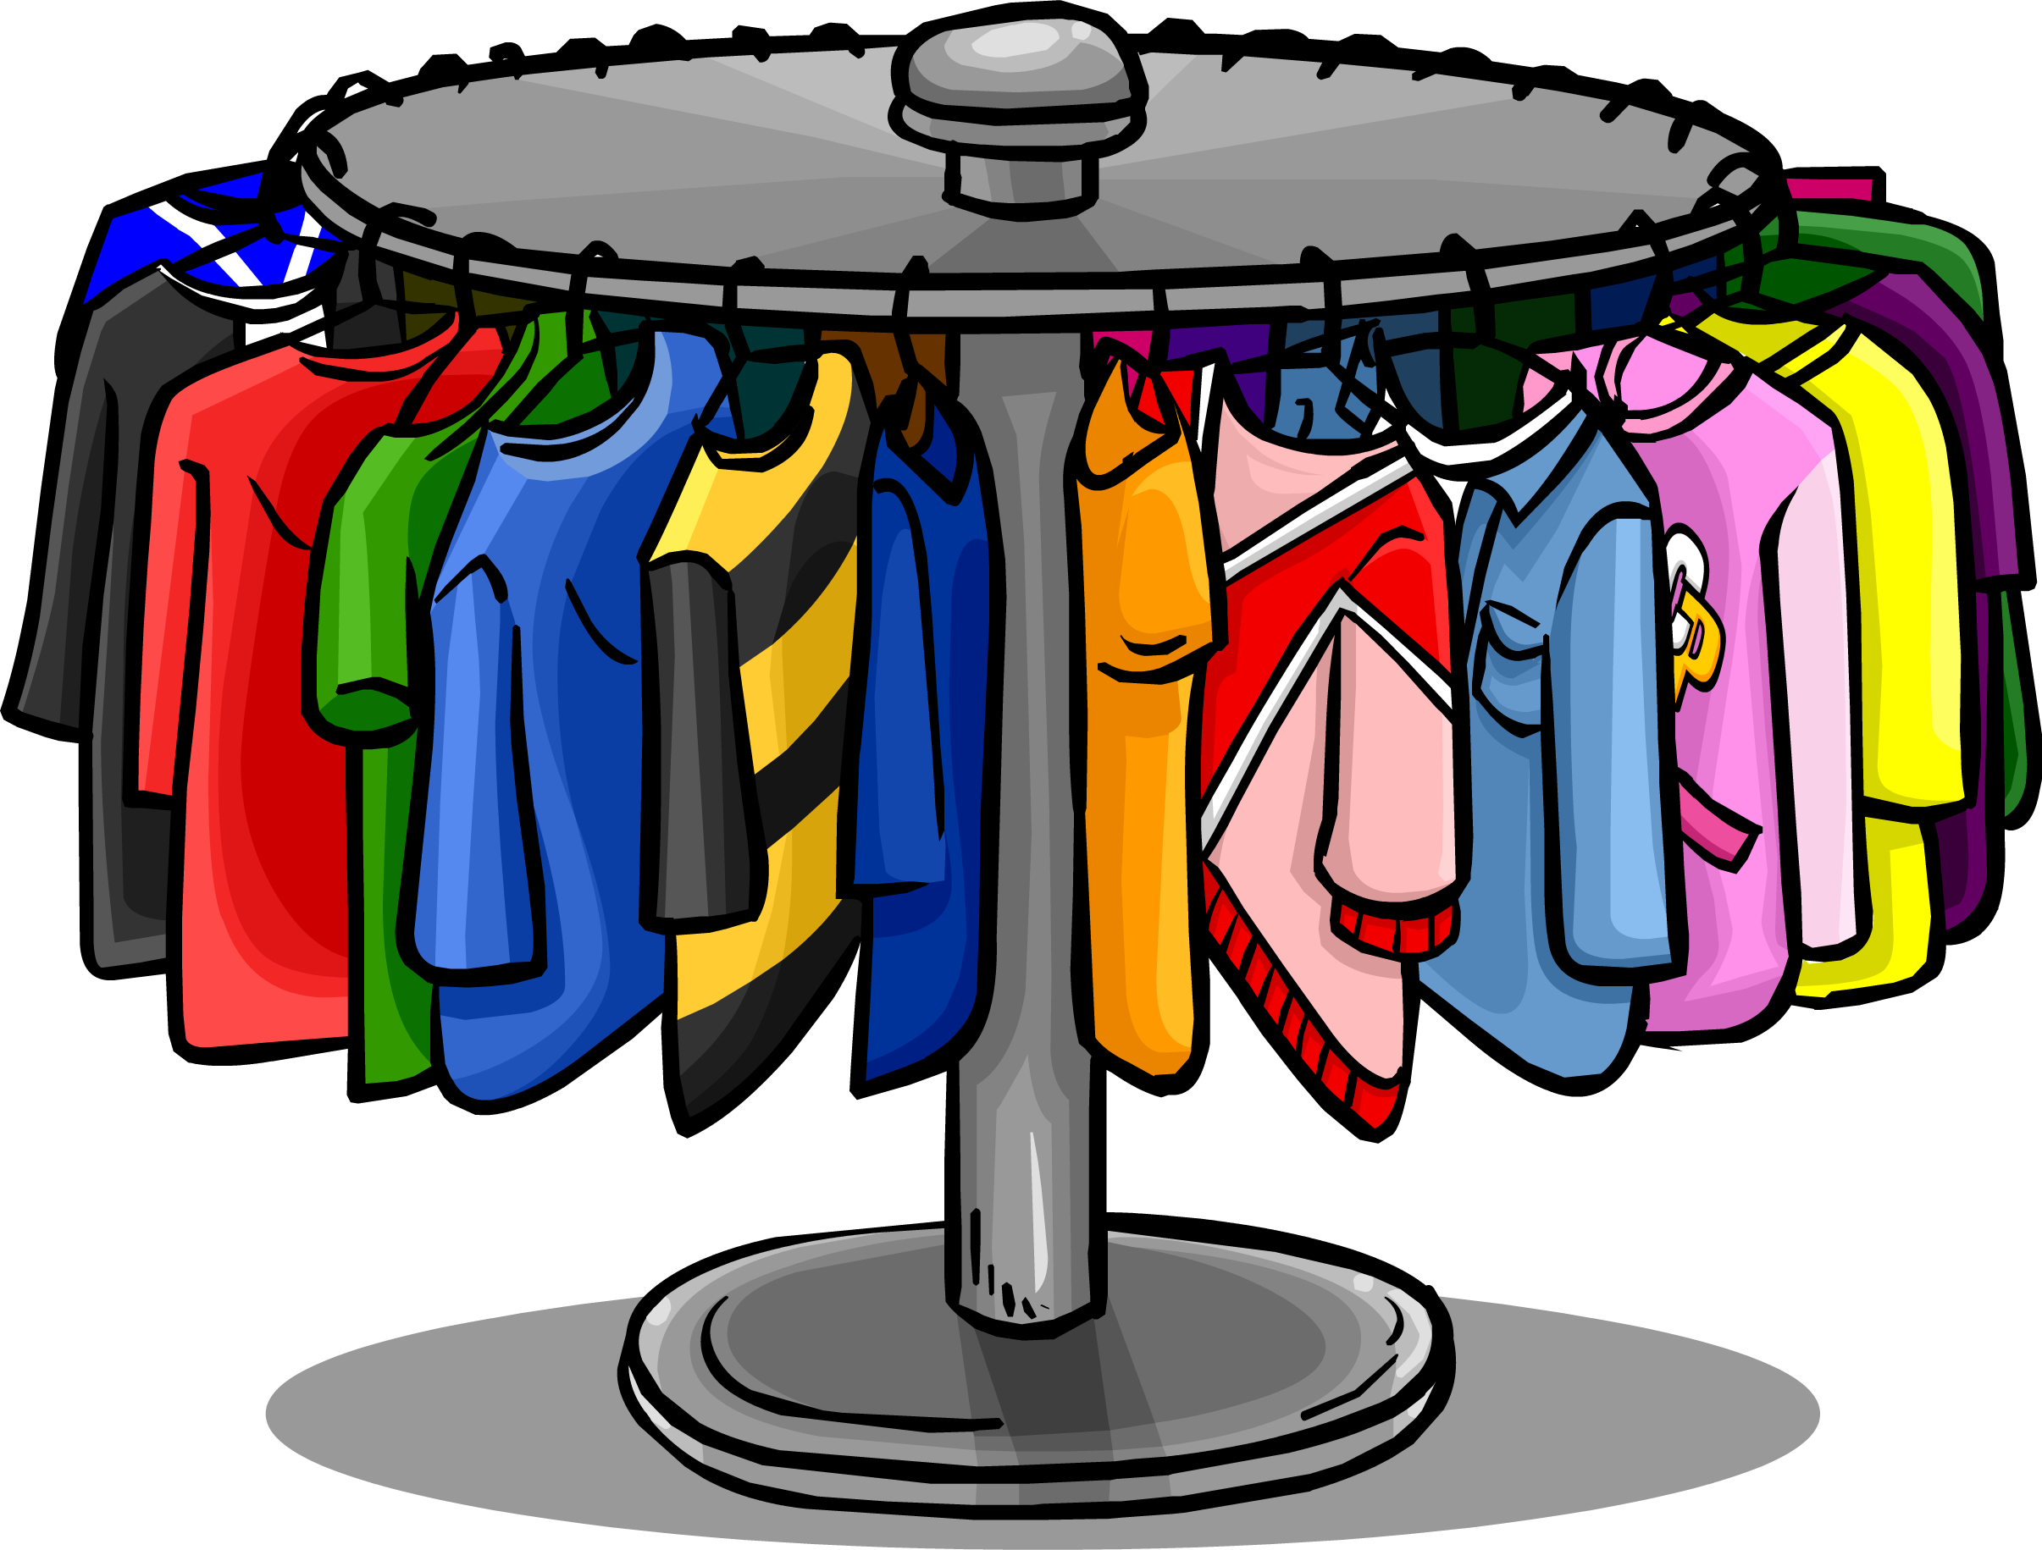
THE RAG TRADE
The business of designing, making and selling clothes
The Fashion Industry
FAITH GRAY

Slide 2
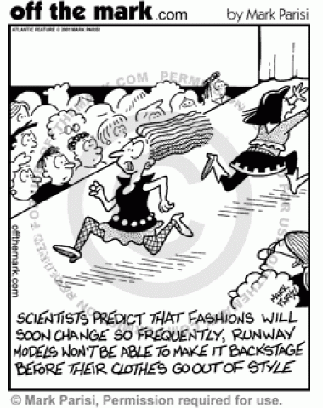

Slide 4
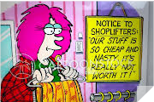
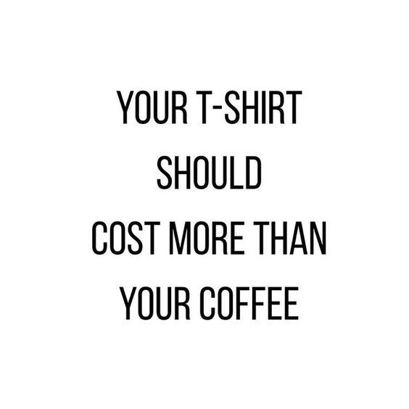

Slide 5
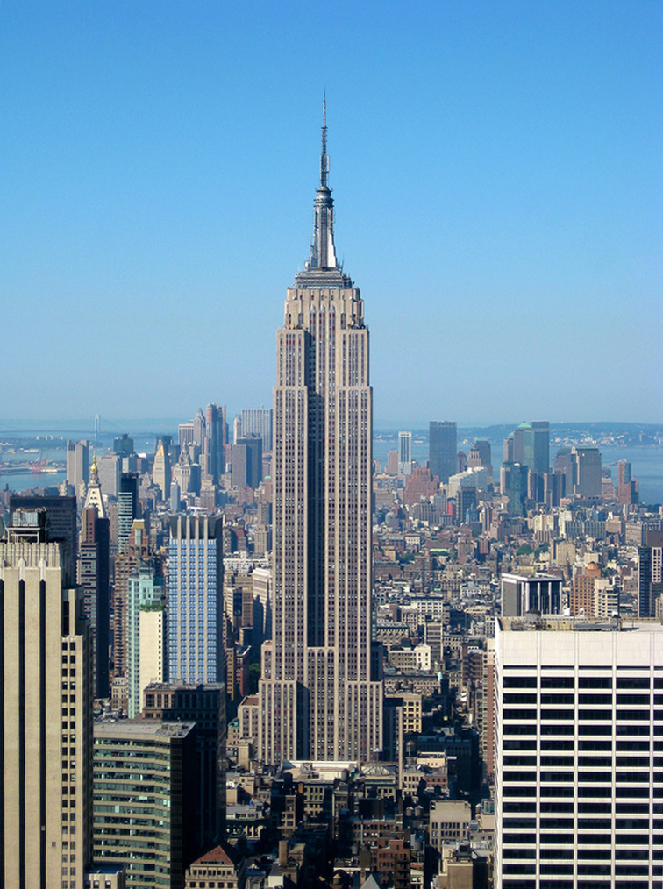
In the USA,
17 million tons of clothing is sent to landfills every year.
That’s about 30 times as heavy as the Empire State Building.

Slide 6
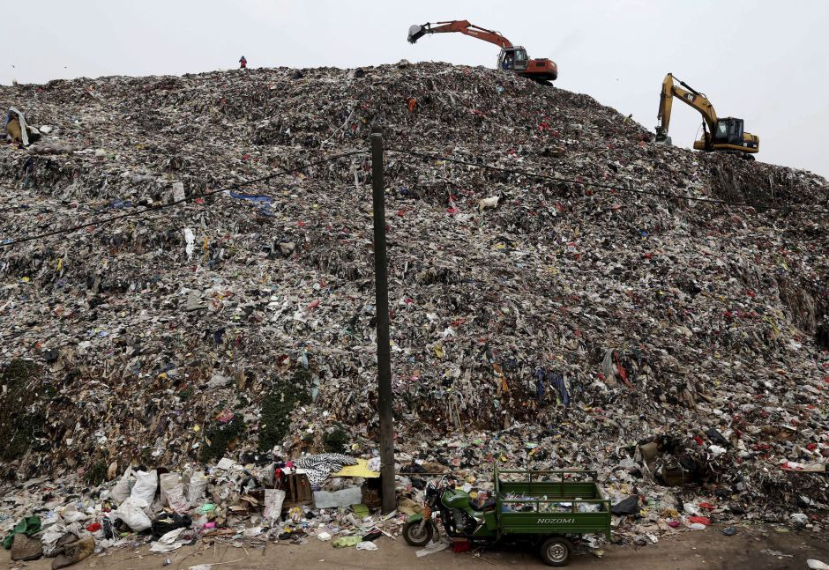
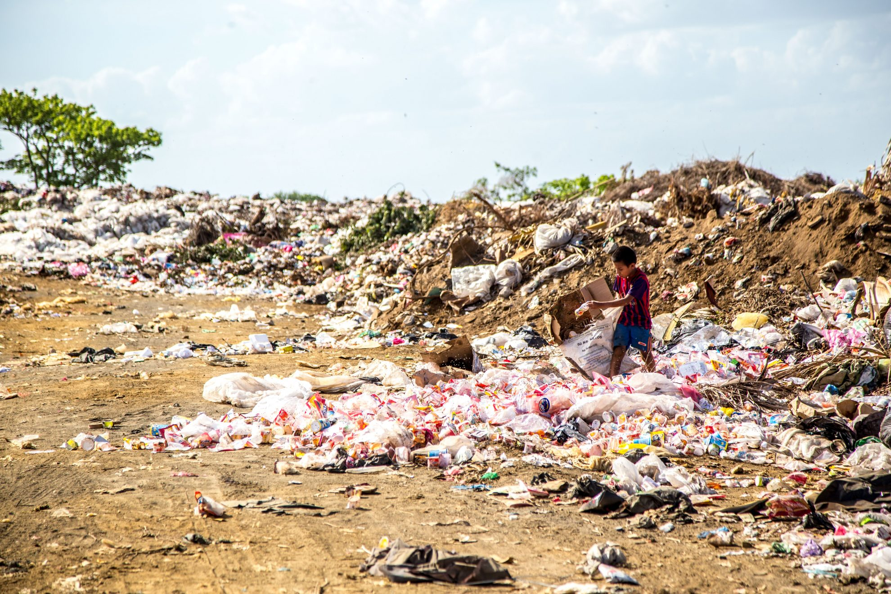

Slide 7
The Fashion Industry

Slide 8
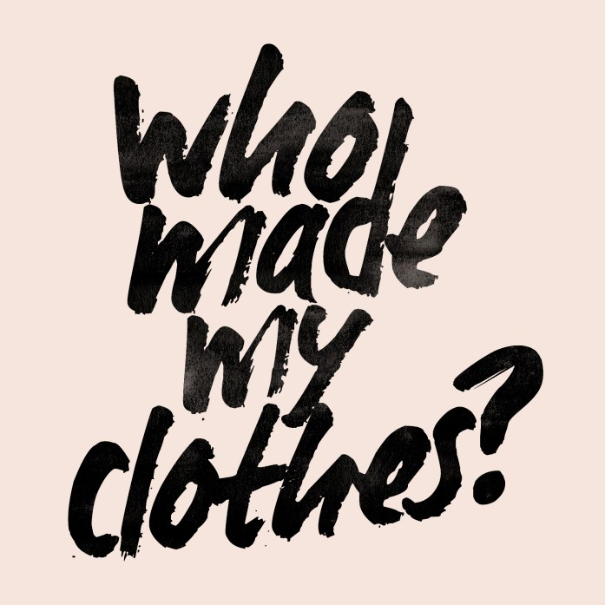
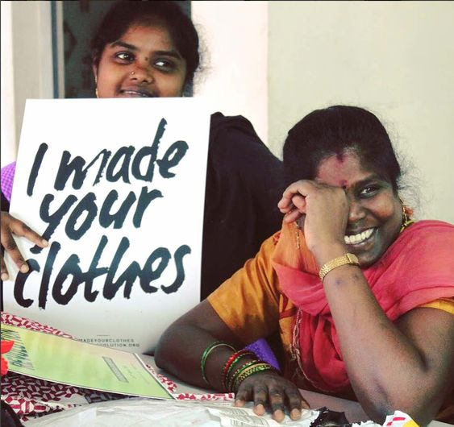
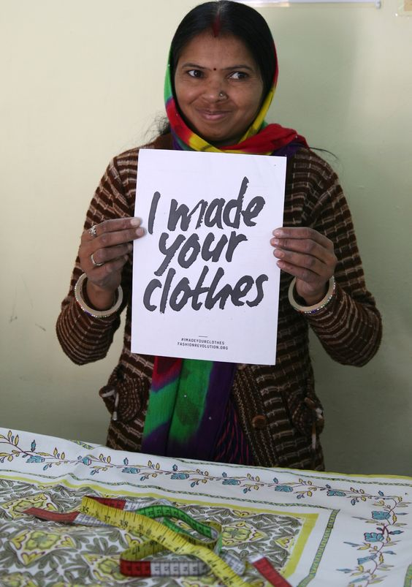
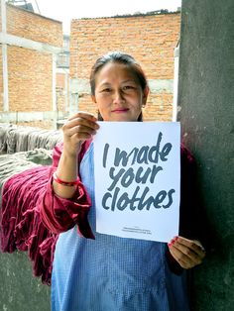
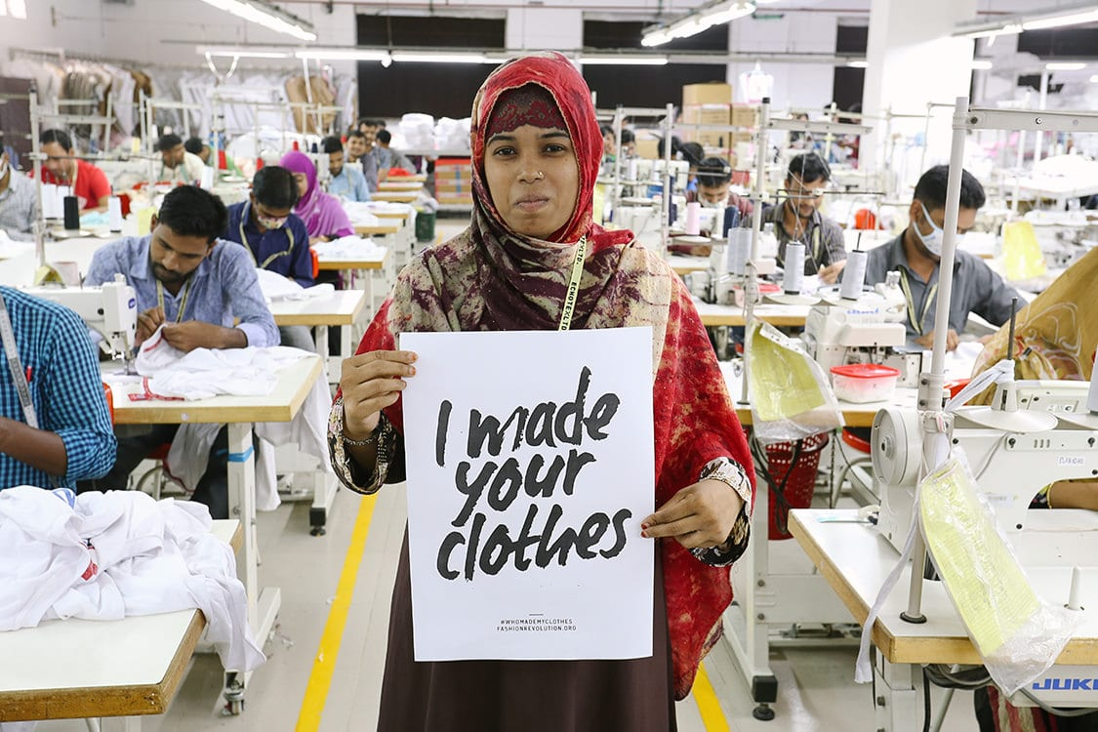

Slide 9
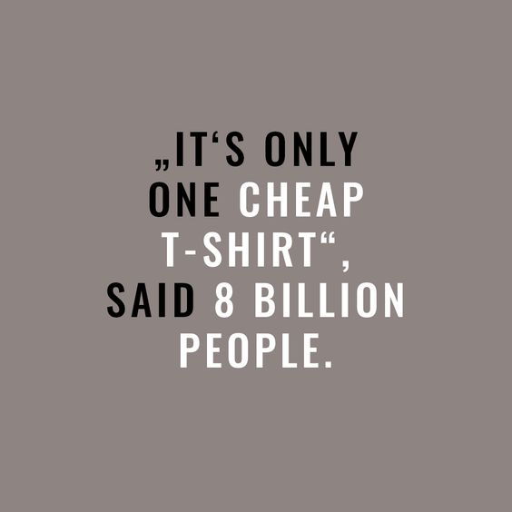

Slide 10
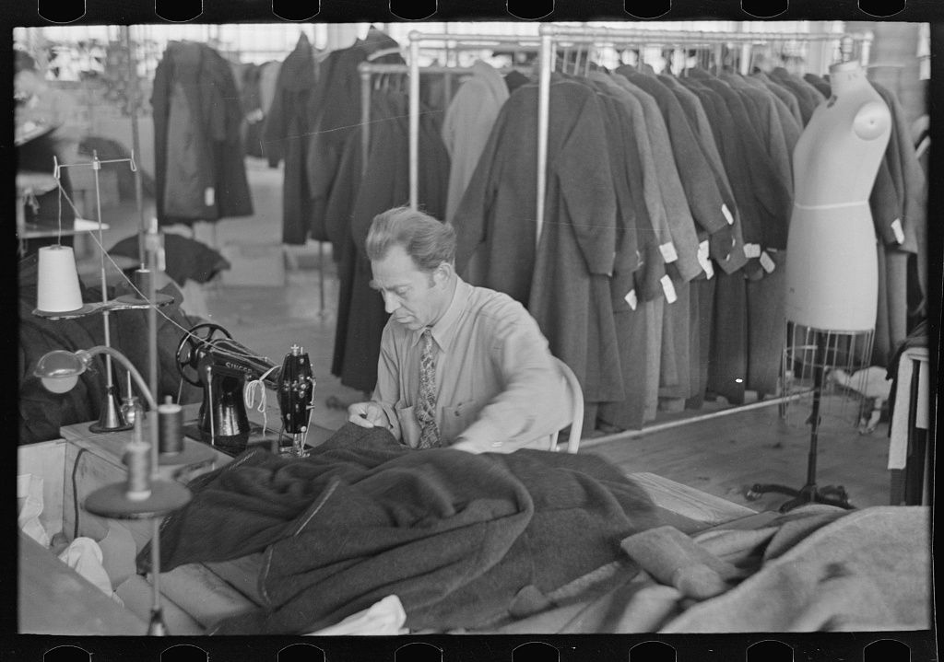
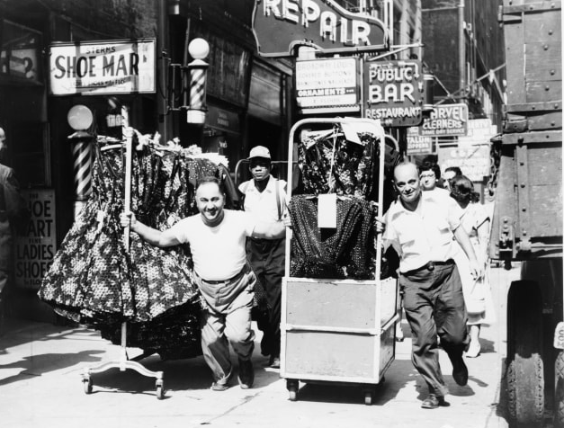
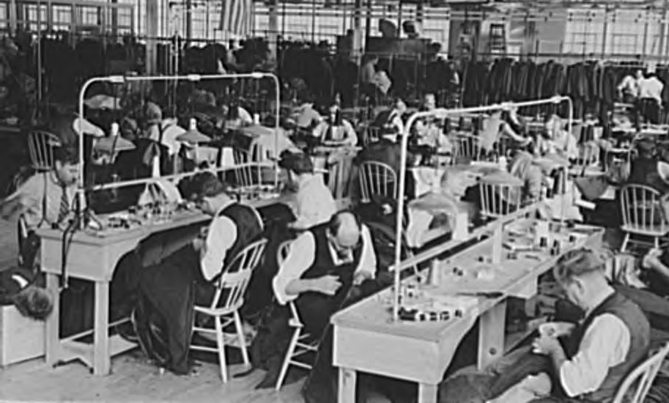

Slide 11
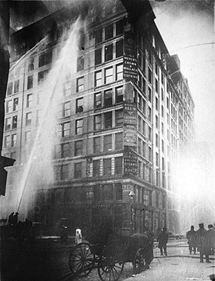
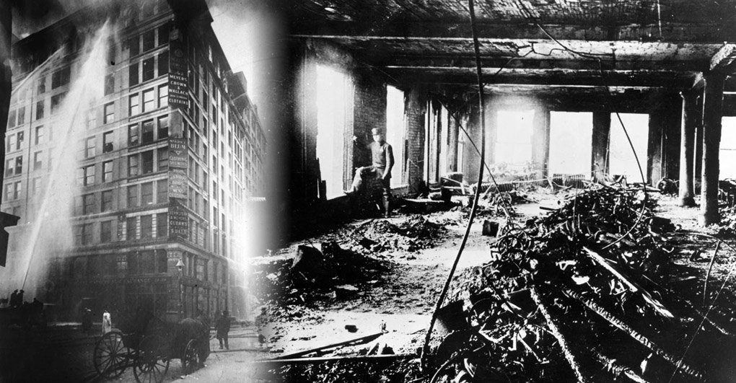
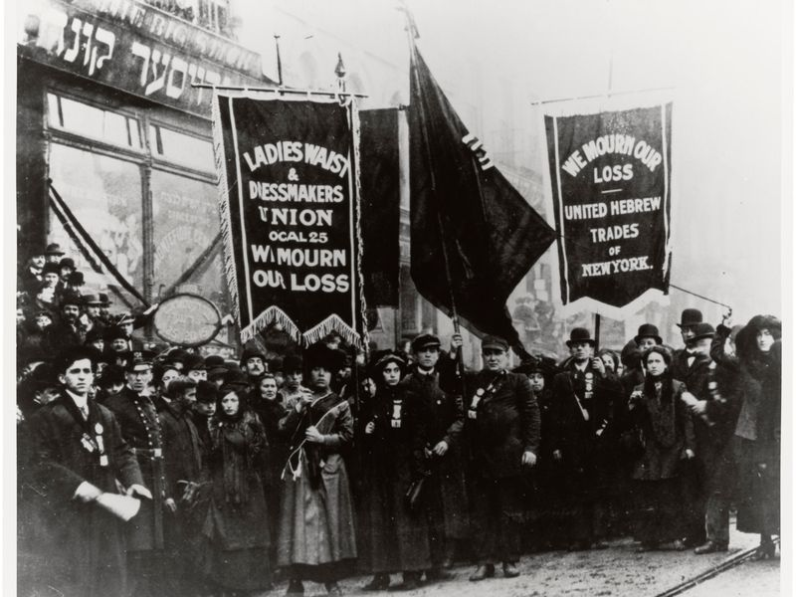
TRIANGLE SHIRTWAIST FACTORY FIRE

Slide 12
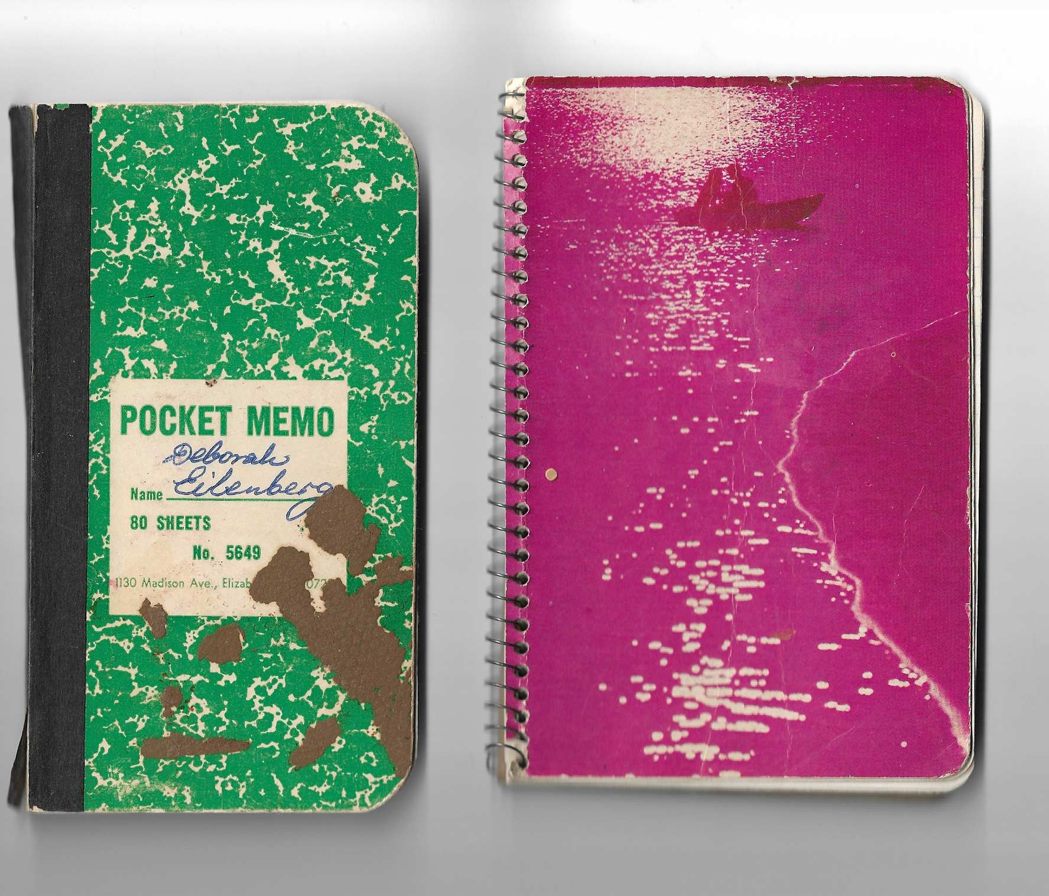
NOTEBOOK RECORDS OF FACTORY PIECE WORK
FROM SHEILA KATZ’S MOTHER - CIRCA 1976

Slide 13
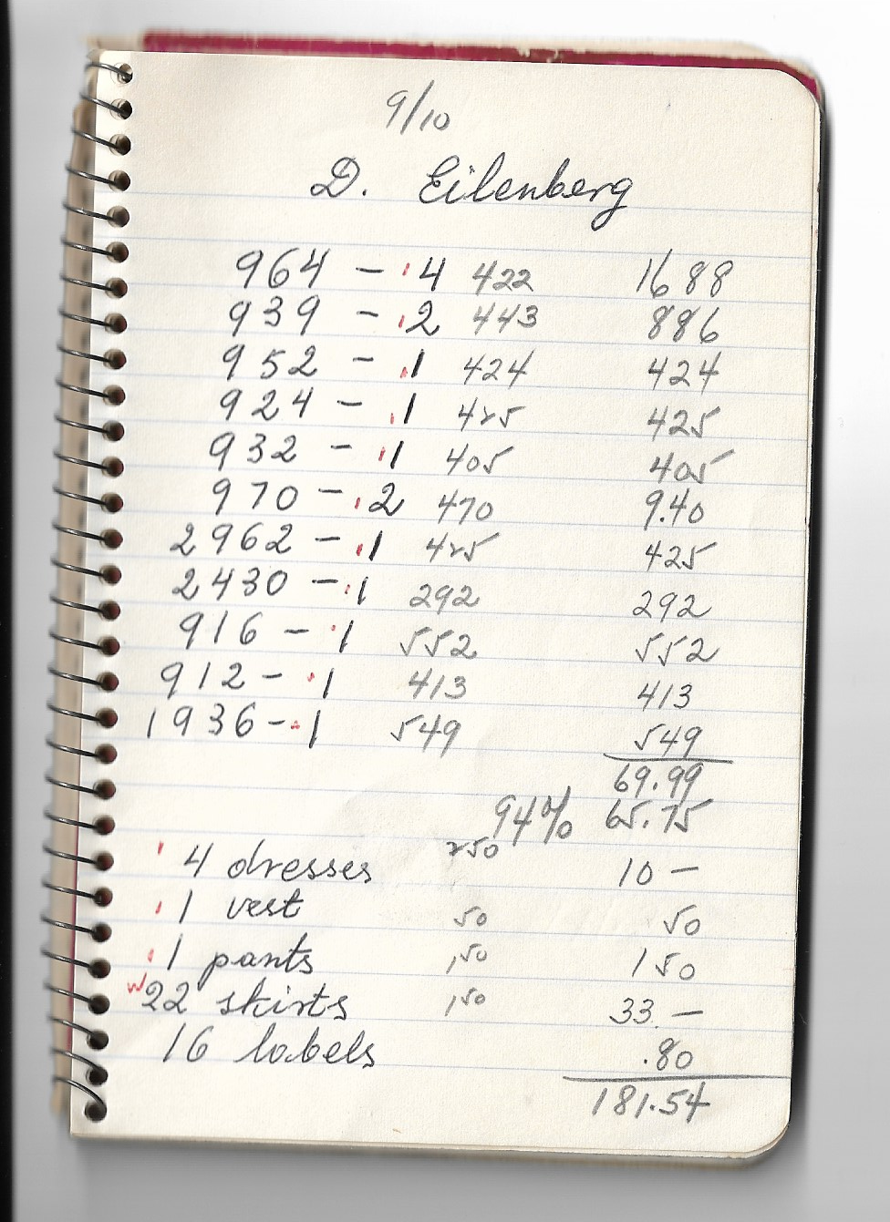
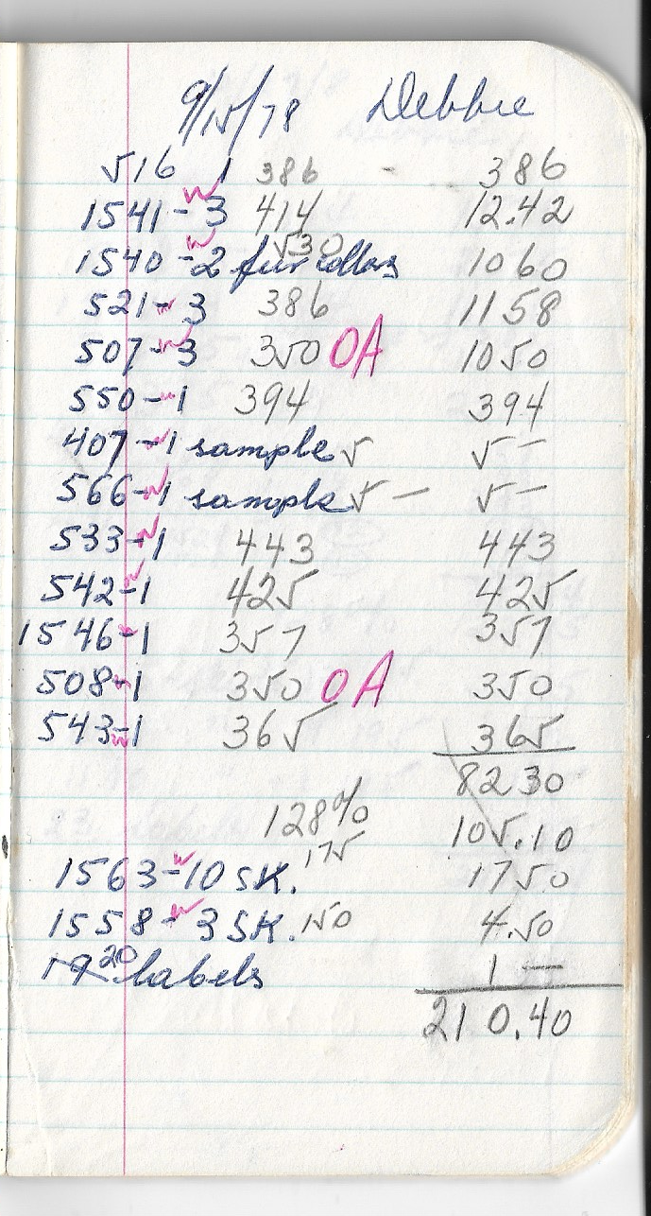

Slide 14
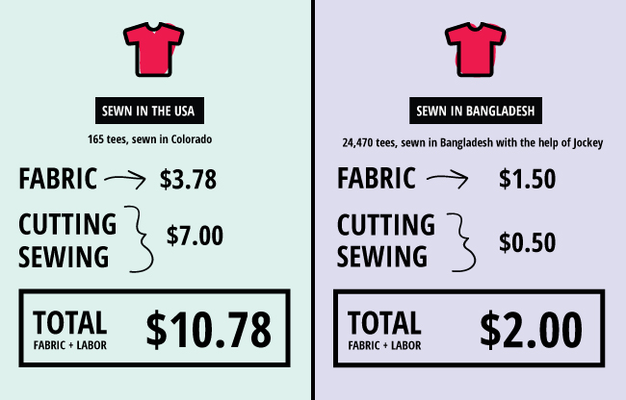
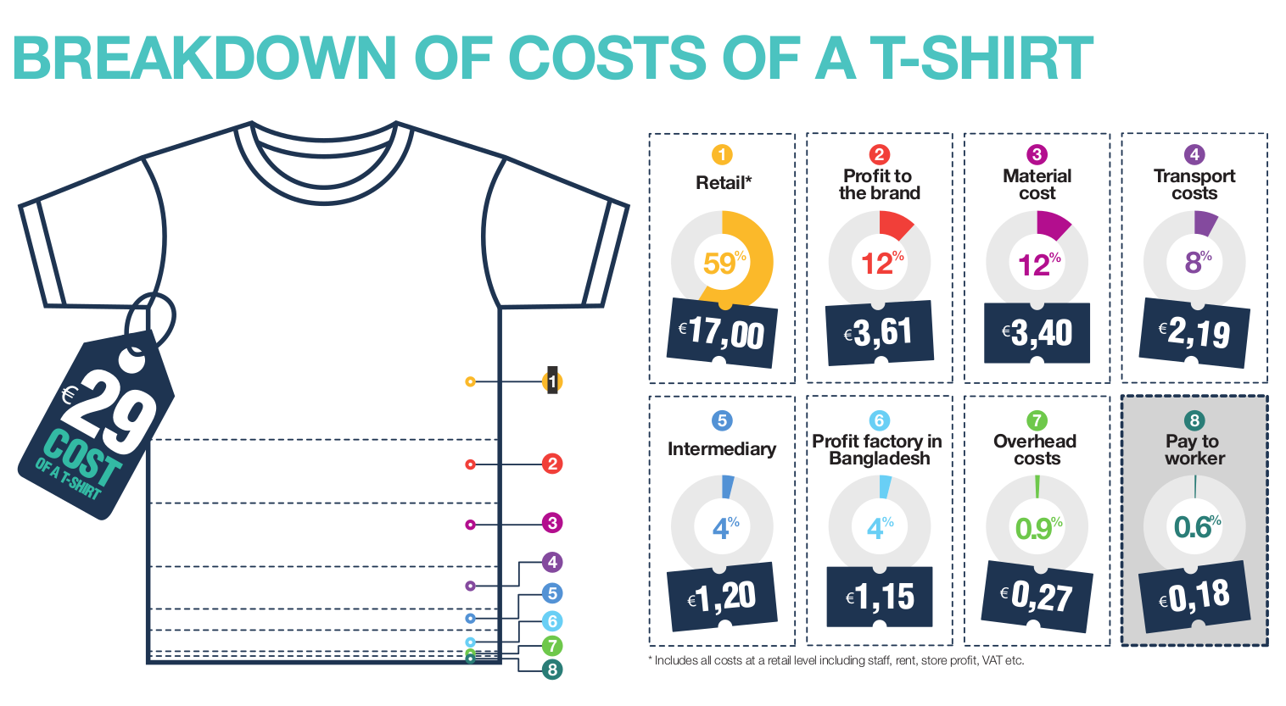

Slide 15
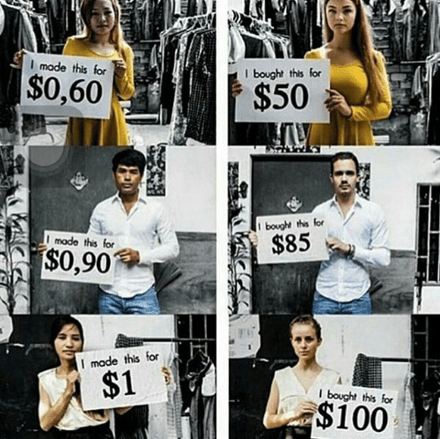

Slide 16
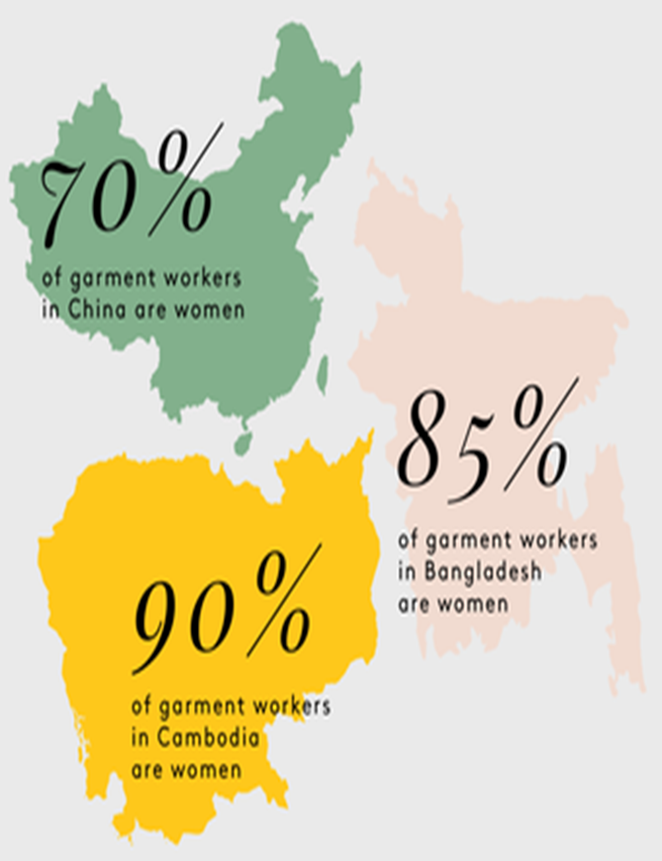
75 million people working globally in the
fashion industry

Slide 17
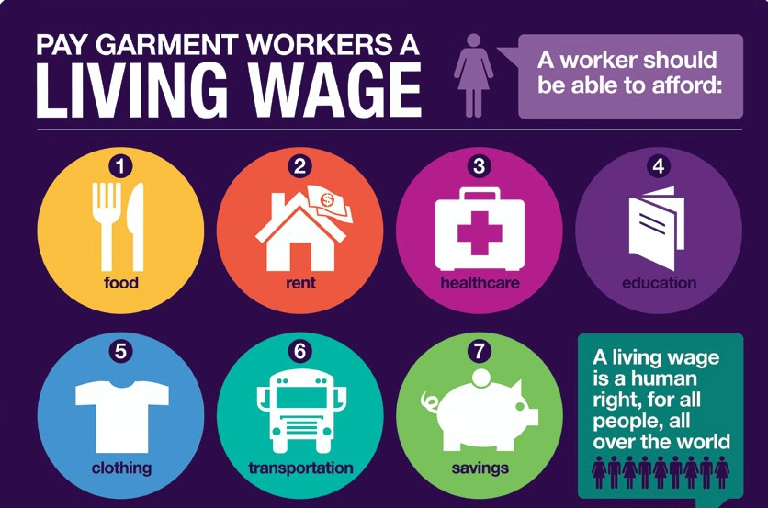

Slide 18
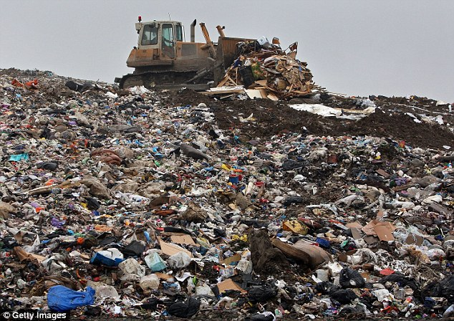
LANDFILLS

Slide 19
SHOPPING FRENZY
FAST FASHION

Slide 20
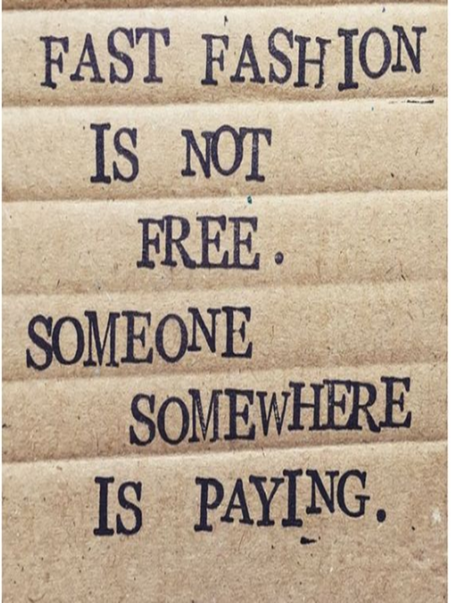

Slide 21
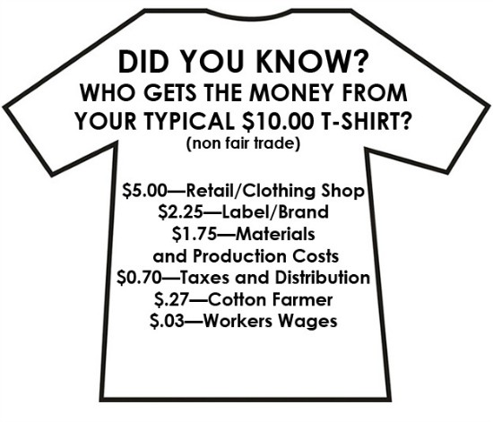

Slide 22
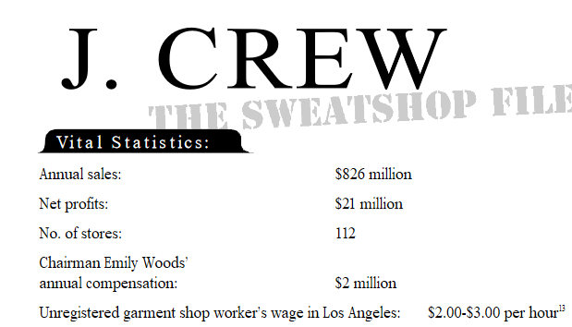

Slide 23
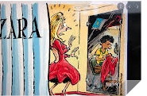

Slide 24
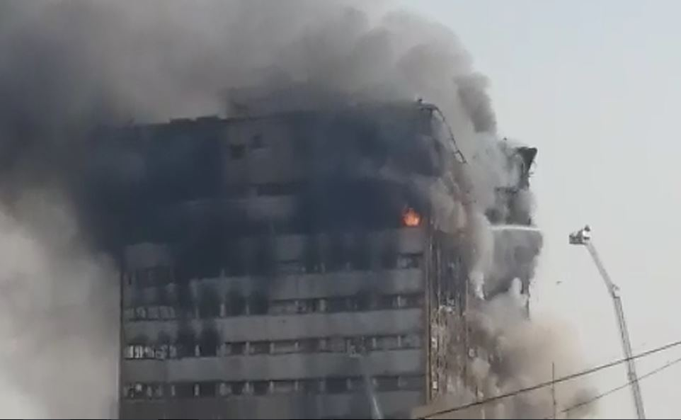
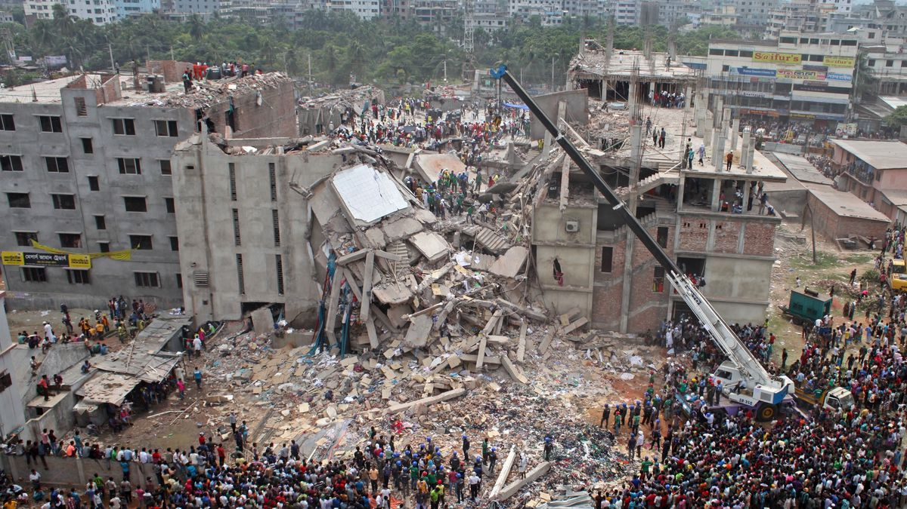
RANA PLAZA
FACTORY FIRE 2013

Slide 25
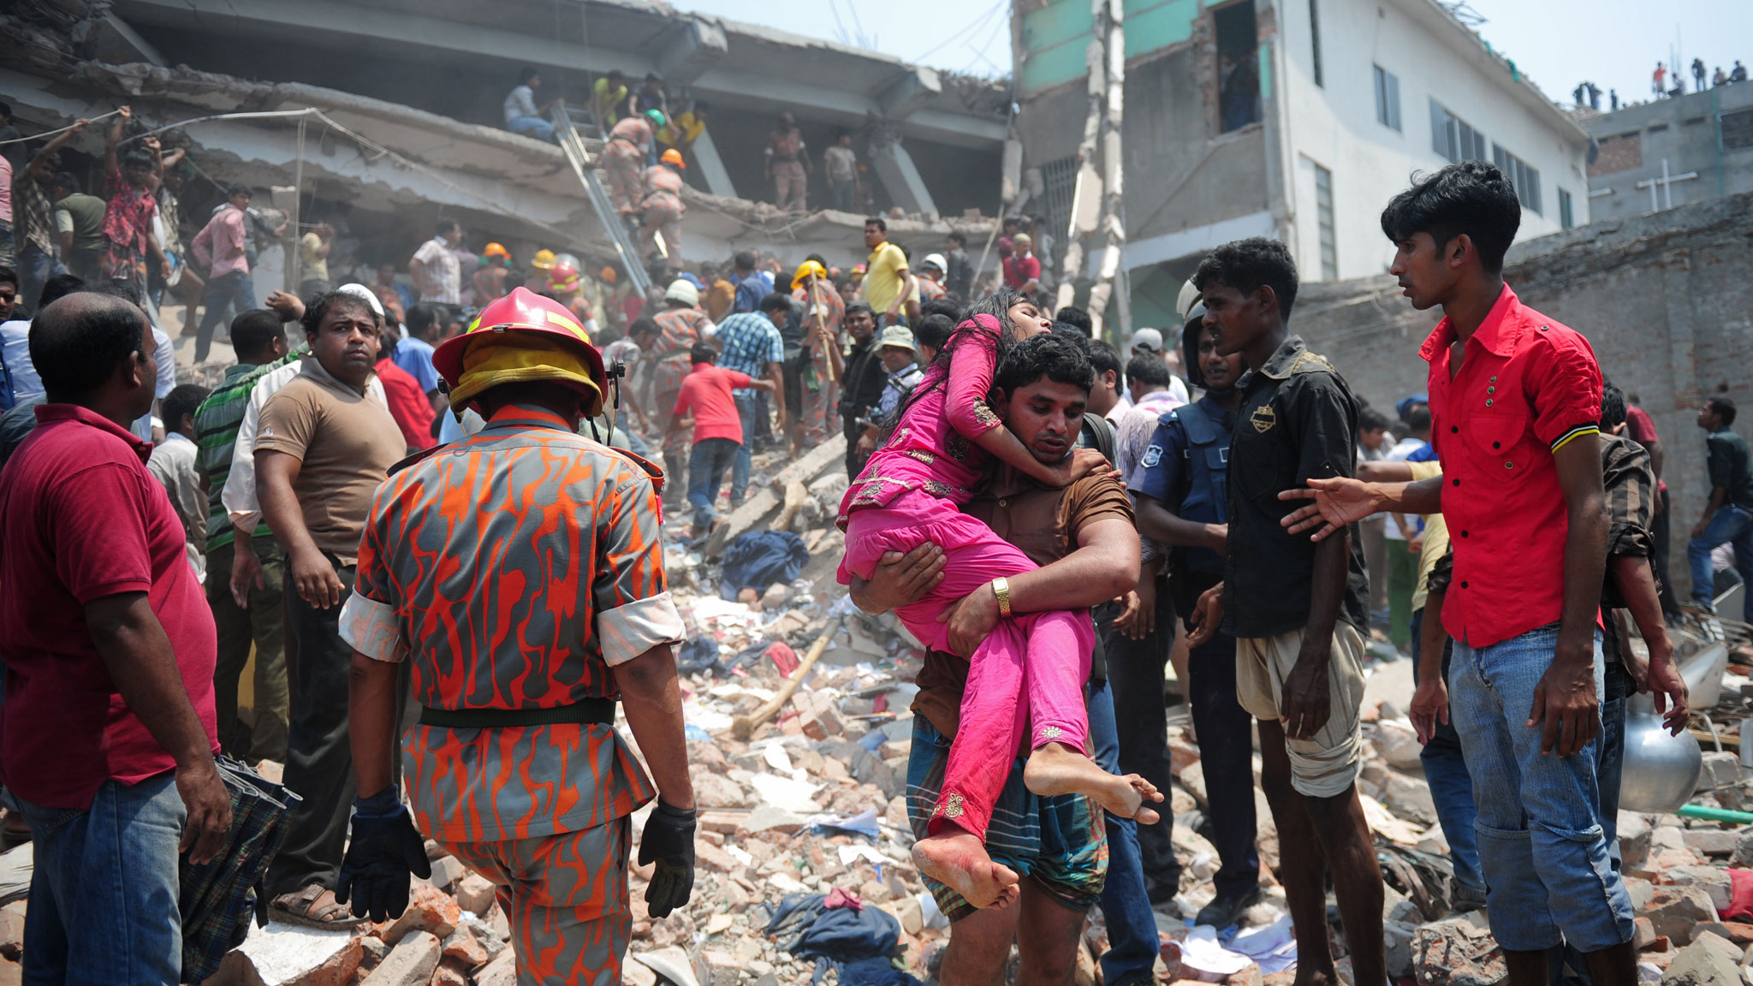

Slide 26
FACTORY DISASTERS
2002 - Dhaka, Bangladesh – 64 dead, 70 injured Zara C
2010 - Gazipur, Bangladesh- 21 killed, 50 injured- H& M Co
2010 - N Dhaka, Bangladesh -27 killed- Gap Co
2012 - Tazreen Fashion Factory, Bangladesh- 117 killed, 200 injured
2012 - Ali Enterprise in Karachi, Pakistan- 300 died, Same day in same place a shoe factory collapses killing 25
2015 - Kentrix factory – Philippines – 72 dead, 45 injured
2005 - Bangladesh- Spectrum Sweater Company - 64 people killed, 80 injured
2010 - Sporting goods factory for Gap, Tommy Hilfiger, and Kohls and several others collapsed, 100 died, 29 injured
2010 - Unnamed factory - 117 died
Between 2012- 2016, 1600 garment workers died in factory fires.

Slide 27
In 1990, Kathy lee Gifford hired underage workers in Hondurus, and was sued for making USA labels in Saipan, a tiny island between Hawaii and the Philippines.
On April 11, 2005 in Bangladesh, Spectrum Sweater Industries, a shoddy factory, imploded after midnight killing 64 people and wounding 80 more.
In December, 2010, the 10-story building that produces IT sporting goods for Gap, Tommy Hilfiger, Kohls and many others, caught on fire,
100 people injured and 29 died.
In November of that year, another fire occurred in an unnamed building. When the workers shouted fire, the manager and supervisor locked the doors and told them to keep working. 1,100 people were trapped inside, 117 people died and nearly half were burned beyond recognition. Investigators found the labels from
Sears, Walmart and Disney.
In 2018, 10% of parliament members owned garment factories and 30% had family members who owned a factory.

Slide 28
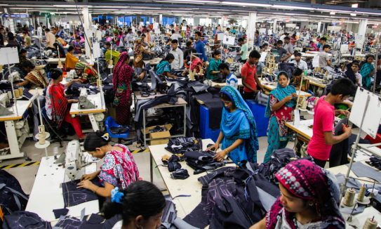
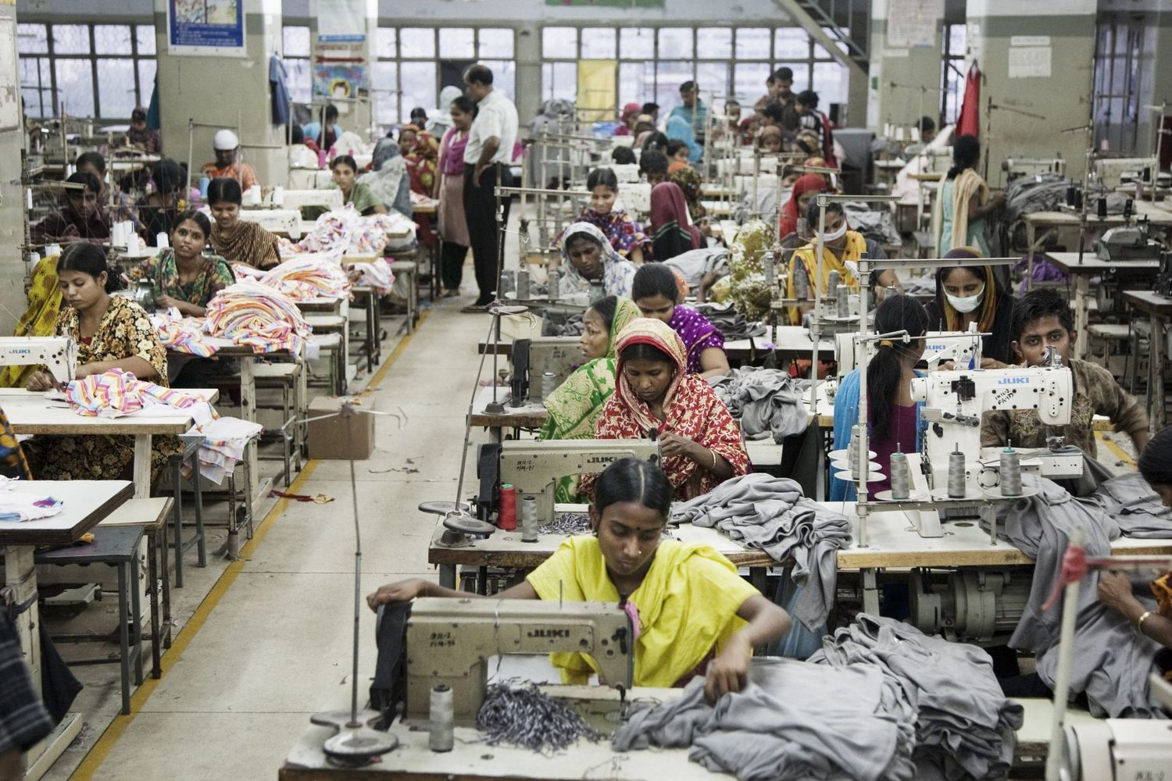

Slide 29
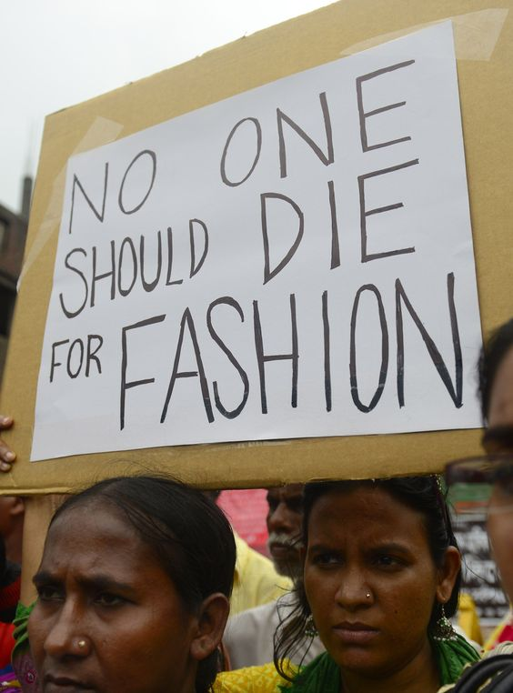
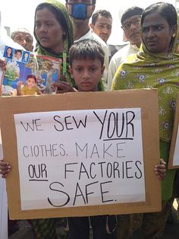

Slide 30
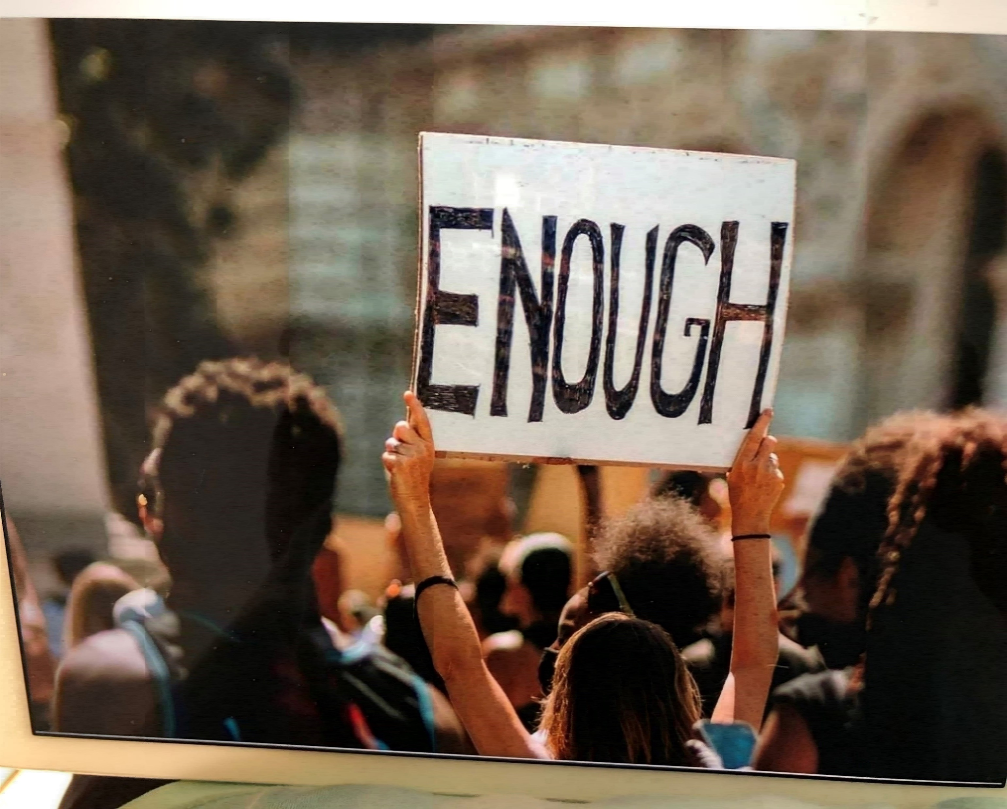

Slide 31
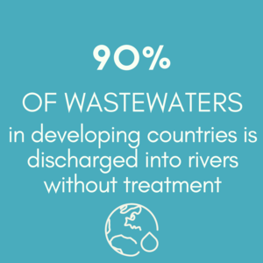
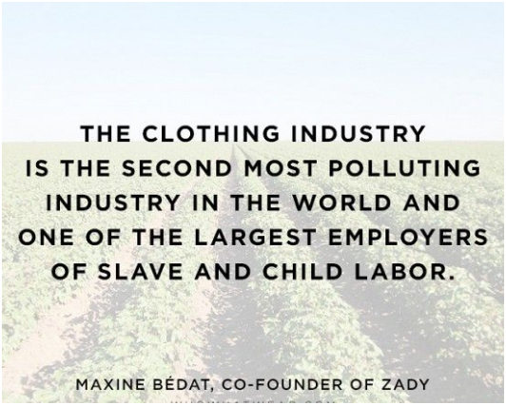
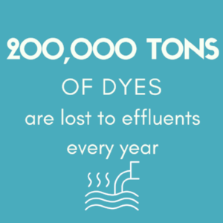

Slide 32
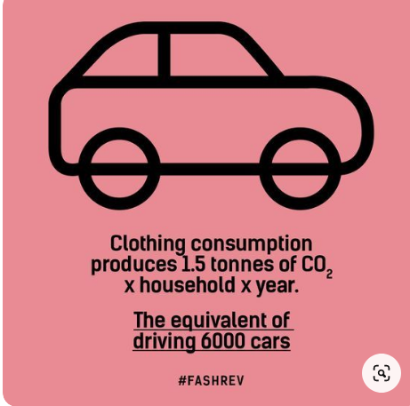
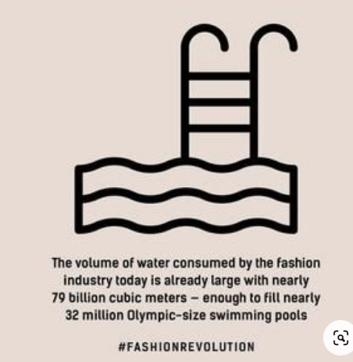
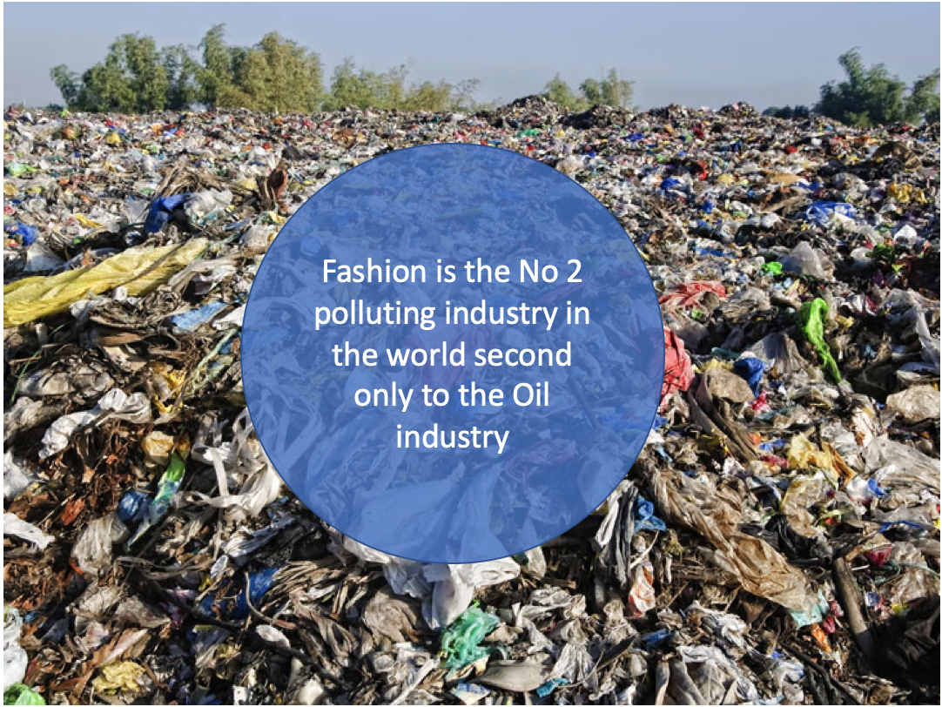
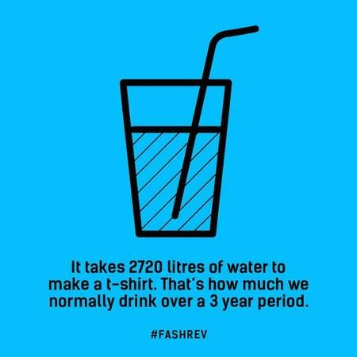

Slide 33
Fast fashion has had an intensely negative impact on our world, our economics, our people and our land. It has been our consumption that has caused the problem. Let’s not be casual any longer.

Slide 34
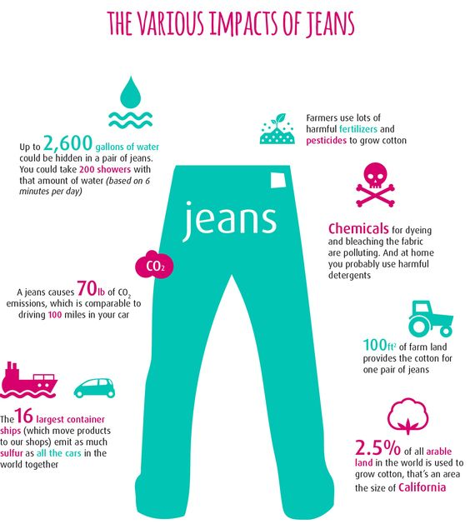

Slide 35
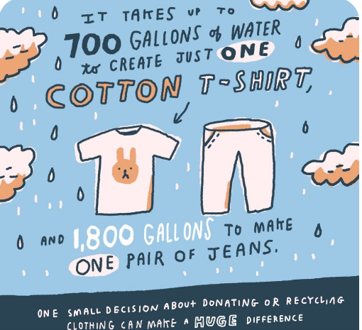
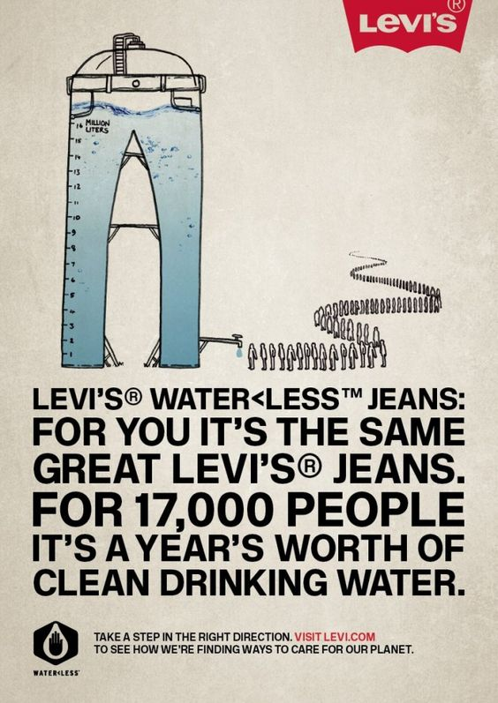

Slide 36
The style?????? Someone some place is ripping this and wondering why

Slide 40
USED CLOTHING TO BE SENT OVERSEAS

Slide 41
Used clothing markets like Gikomba, Nairobi can be found all across Africa

Slide 42
RAG PICKERS IN INDIA

Slide 43
LEAST SUSTAINABLE FABRICS
All non- biodegradable
Uses large amounts of water
Pesticides, toxic chemicals
Polyester
Acrylic
Conventional Cotton
Rayon
Nylon
MOST SUSTAINABLE FABRICS
Uses little or no pesticides
Less land, less water Biodegradable
1. Organic Cotton
2. Linen
3. Tencel
4. Recycled polyester
5. Hemp
6. Bamboo

Slide 44
Think before you give away - never just throw out
Buy what you love - keep what you love
Donate to a legitimate cause - only clean and good condition clothing
Rent the onetime evening dress, prom dress
Swap your clothes with a friend
Go to a consignment shop for the best deals

Slide 46
“EVERY TIME YOU SPEND MONEY, YOU’RE CASTING A VOTE FOR THE KIND OF WORLD YOU WANT.”
Anne Lappe
T

Slide 47
THE MOST SUSTAINABLE GARMENT IS THE ONE ALREADY IN YOUR WARDROBE

Slide 48
THERE IS NO SUCH THING AS AWAY…
IT ALL GOES SOMEWHERE
Annie Leonard, Director of Greenpeace USA

Slide 49
LET’S CELEBRATE THE CREATIVE POWER OF HUMANS AROUND THE WORLD, SHARE THE BENEFITS AND STOP LOOKING AT OUR LAND AS A COMMODITY TO BE USED BUT AS A BASIS FOR OUR VERY EXISTENCE. HOW MUCH DO WE CARE ABOUT SAVING MOTHER EARTH. THERE HAS TO BE A BETTER WAY.
QUOTE FROM “TRUE COST” DOCUMENTARY

